Slide 1
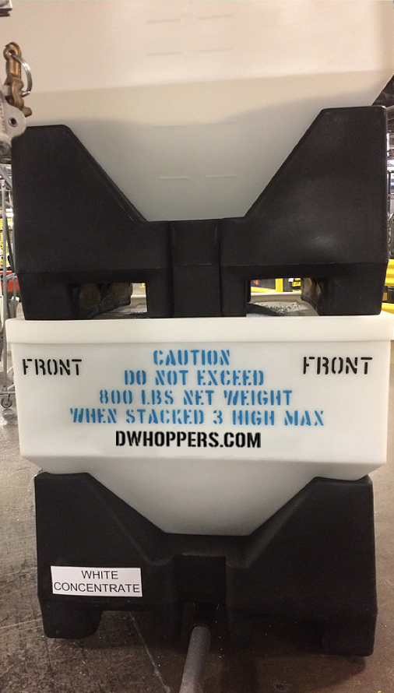
DW Hoppers Keep it Clean-Keep it Simple
Eliminate Material Handling Challenges Such as:
Contamination
Storage of Color and Different Resin Types
Dust Control from Regrind
Housekeeping and Space Saving
Increase Equipment Efficiency
Decrease Downtime
Eliminate Waste and Decrease Scrap
Safer and Ergonomic Work Environment
Our Vacuum Hoppers are easily installed and take the place of traditional cardboard gaylords. Most Facilities have upgraded to our hoppers with little to no additional installation costs.
Contact: dw@dwhoppers.com Phone: 859-466-5065

Slide 2
About Our Product
Features:
Hoppers can be moved and stacked up to 3 high via fork truck, saving you valuable floor space.
Available with vacuum line attachment or slide gate
Semi-Transparent hopper allows for visual level indication.
Removable Lid prevents contamination.
Color Coded bases allow for easy inventory of materials.
Eliminates dust, spills and cross contamination.
Comparable size and capacity of traditional cardboard Gaylord bins
Cone shaped bottom ensure all material is used up, leaving no waste at bottom
Made of Durable long lasting material
Easy to clean and reusable
ROI in as little as 16 months
At DW Hoppers, we know and understand the daily challenges facing Plastics Manufacturers and their material handling needs. Our hoppers have been designed and field tested by a variety of plastics manufacturers in various settings and applications. Let DW Hoppers start saving you TIME and MONEY today and start using the technology that your competitors are already using.

Slide 3
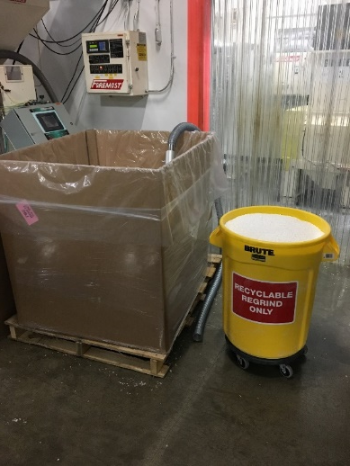
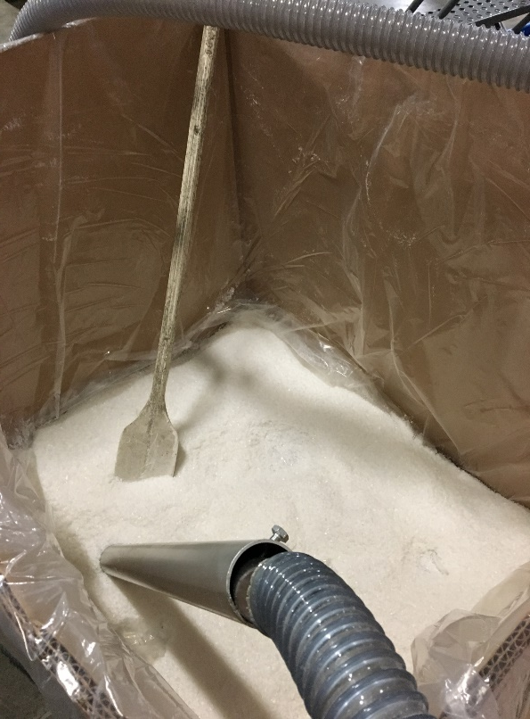
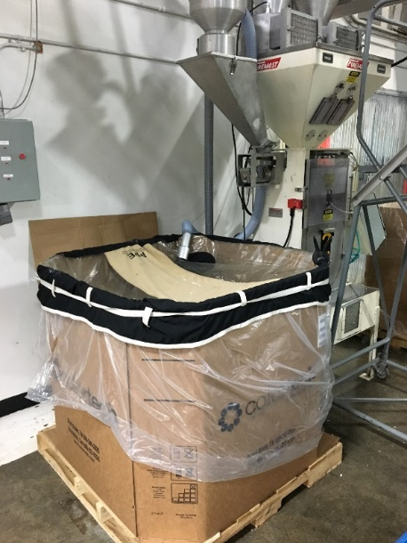
Current System Flaws
Safety and Ergonomics
Trash cans or tubs and buckets are overfilled by personnel and exceed maximum lift weight
Team Lift is commonly used but still exceeds weight limit
Potential risk for back injury or muscle strain
Resin/Regrind commonly spills on floor causing slip hazard for personnel
Contamination Risk
Gaylords can become contaminated with dust or debris during setup, when being filled, or while sitting for lengths of time with tops or caps that are not secure
Cardboard pieces or dust in Blow Molding room
Different Plant personnel adding regrind to these bins over 3 shifts
Materials of different types can become mixed together
White regrind inadvertently mixed with natural regrind
Vacuum wands need regular adjustment when material gets low or wand becomes clogged, top of bin must be uncovered to do this.

Slide 4
How It Works
Installation and utilization:
Use DW Hoppers:
Beside machine for material feeding
General storage and space saving
During color changeovers or material change
In grinder rooms to store excess regrind
Rework or custom blends
Hoppers connect to existing material systems via 3” Vacuum port on bottom of hopper.
Stack Hoppers up to 3 high. Bottom hopper has vacuum port, top 2 have slide gate.
Monitor material level through transparent hopper walls.
When bottom hopper empties, open hatch on hopper lid, then open slide gate to gravity feed material from top to bottom without spills or contamination risk.
When top hoppers are empty, remove with fork truck and easily clean with compressed air.
Refill hopper and place back on stack

Slide 5
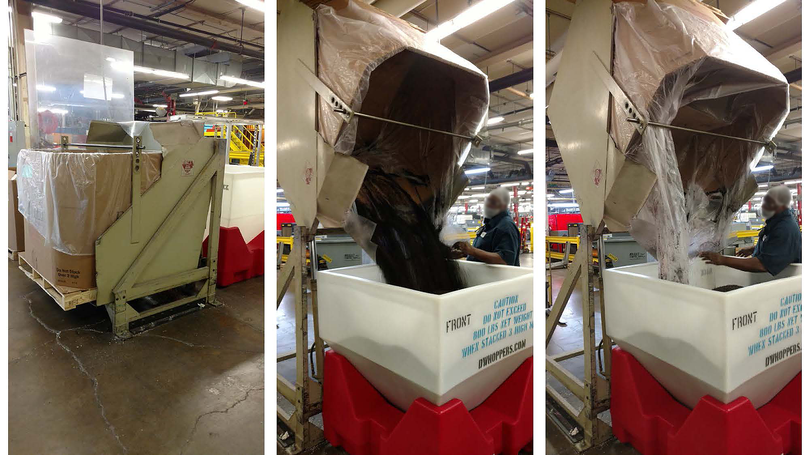
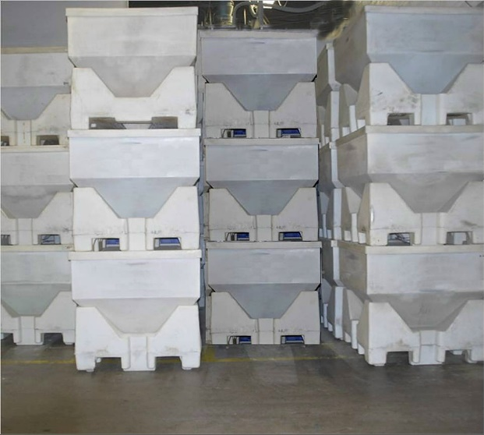
Real World Applications
An employee empties a cardboard Gaylord and uses tipper to load hopper. Color coded base allows for easy material identification
A hopper being prepared to be loaded.
Clean and organized material storage

Slide 6
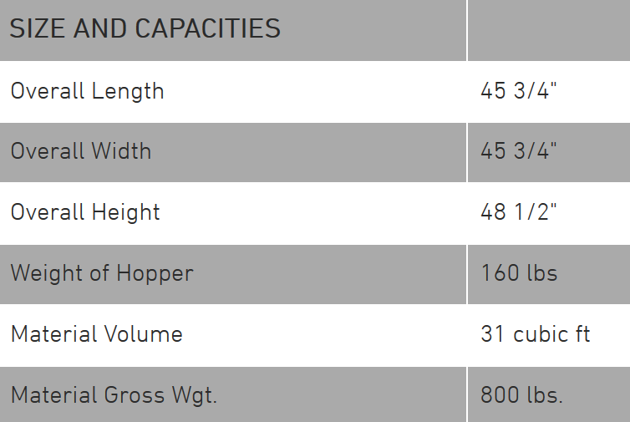
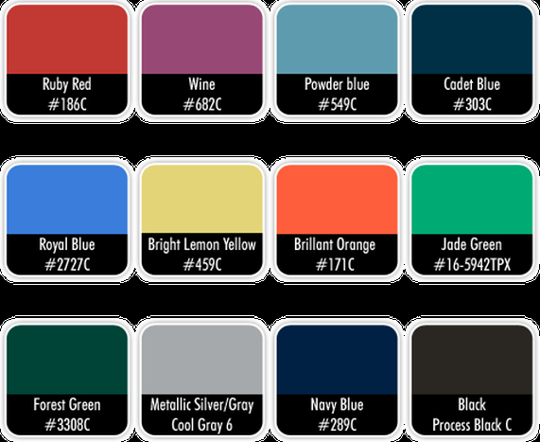
SPECIFICATIONS
Hopper Base Colors

Slide 7
Example ROI
Example A: 4 Line Dairy/Water Extrusion Plant Running 1 Resin Type and 2 Colors
Plant was experiencing high downtime due to contamination from dust and mislabeled regrind bins from color changes. Downtime was decreased by 5% and First Pass Yield Increased by 6% after hopper installation.
Plant was able to reduce amount of scrap/waste after hopper installation. At an average of $0.62/lb for HDPE resin, saving just one Gaylord of scrap pays for the price of a single Hopper.
Plant Operations Manager installed 12 Hoppers and saw ROI in 14 months based on resin/scrap savings alone.

Slide 8
Example ROI
Example B: 12 Line Extrusion Plant Running Multiple Resins types and 4 Colors/Additives
Plant was experiencing high scrap/waste due to poor processes and contamination issues. Due to limited floor space, regrind/rework resin was often scrapped due to not being able to store it and rework back into lines.
Plant estimates downtime to be decreased by 4%.
By stacking hoppers 3 high, plant was able to regain valuable floor space and decrease scrap/waste.
Plant Manager Installed 32 hoppers less than 6 months ago. ROI is projected to be 16-18 months from purchase if trends continue on current path.

Slide 9
Start Saving TIME and MONEY Today!
We understand that daily challenges our customers face when it comes to material handling. Plant managers love the cost savings and operators love the ease of use and simplistic yet durable design. Our hoppers were designed with YOU, the customer, in mind. Let us help you start saving time and money today.
Contact: dw@dwhoppers.com Phone: 859-466-5065

